Slide 1
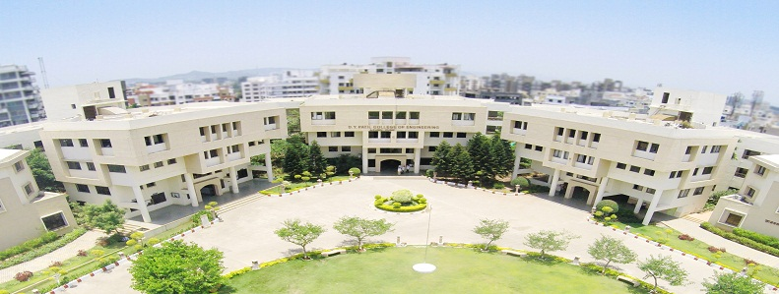
Project STAGE – I presentation on bus tag
D. Y. Patil College of Engineering, Akurdi, Pune
Presented by: PROJECT GUIDE:
RISHIKESH MUNDADA 72018301E DR. K. D. BAMANE
VAISHNAVI VAIDYA 72018624C ASSOCIATE PROFESSOR
MAYUR BUDHODKAR 72018276L (DYPCOE AKURDI)
JAGRUTI HARNE 72161221M

Slide 2
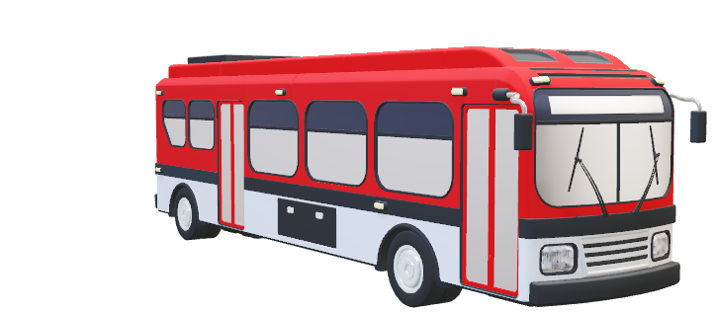
Bus tag
Bus Ticket Booking System

Slide 3
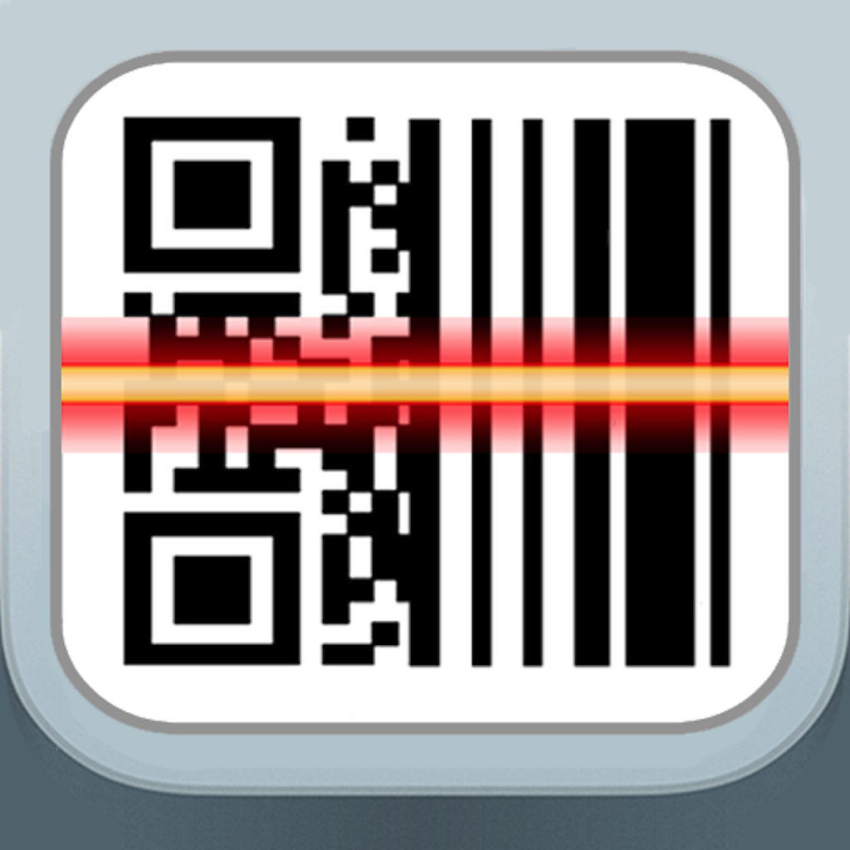
ABSTRACT
We are proposing QR reader for a bus ticket. Users can scan QR reader instead of the ticket. In this app or website, after registration profile, we have to attach our bank details to this and add money to the wallet. Whenever we go by bus, we have to select from and to location. Then it will generate amount details for per head. Also, we can buy a ticket for extra members and produces the mean count. The user will show the bus tag QR code generated in mobile to radio frequency identification(RFID) technology and generates a conductor ID, So directly money will transfer from our wallet to transport corporation on basis of conductor ID. Then user will get an SMS alert for ticket payment proof.
For the users who don’t have smartphones will apply for the QR stickers and can show the sticker in RFID technology then conductor will put the information on the RFID screen and generate conductor ID and make payments and give him payment confirmation receipt.
This Photo by Unknown Author is licensed under CC BY-NC-ND

Slide 4
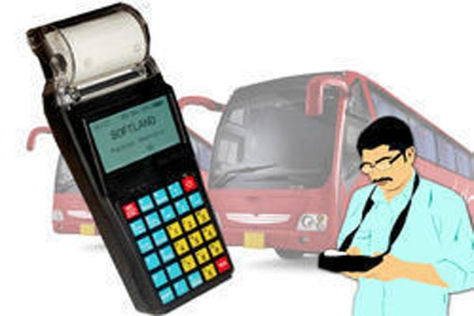
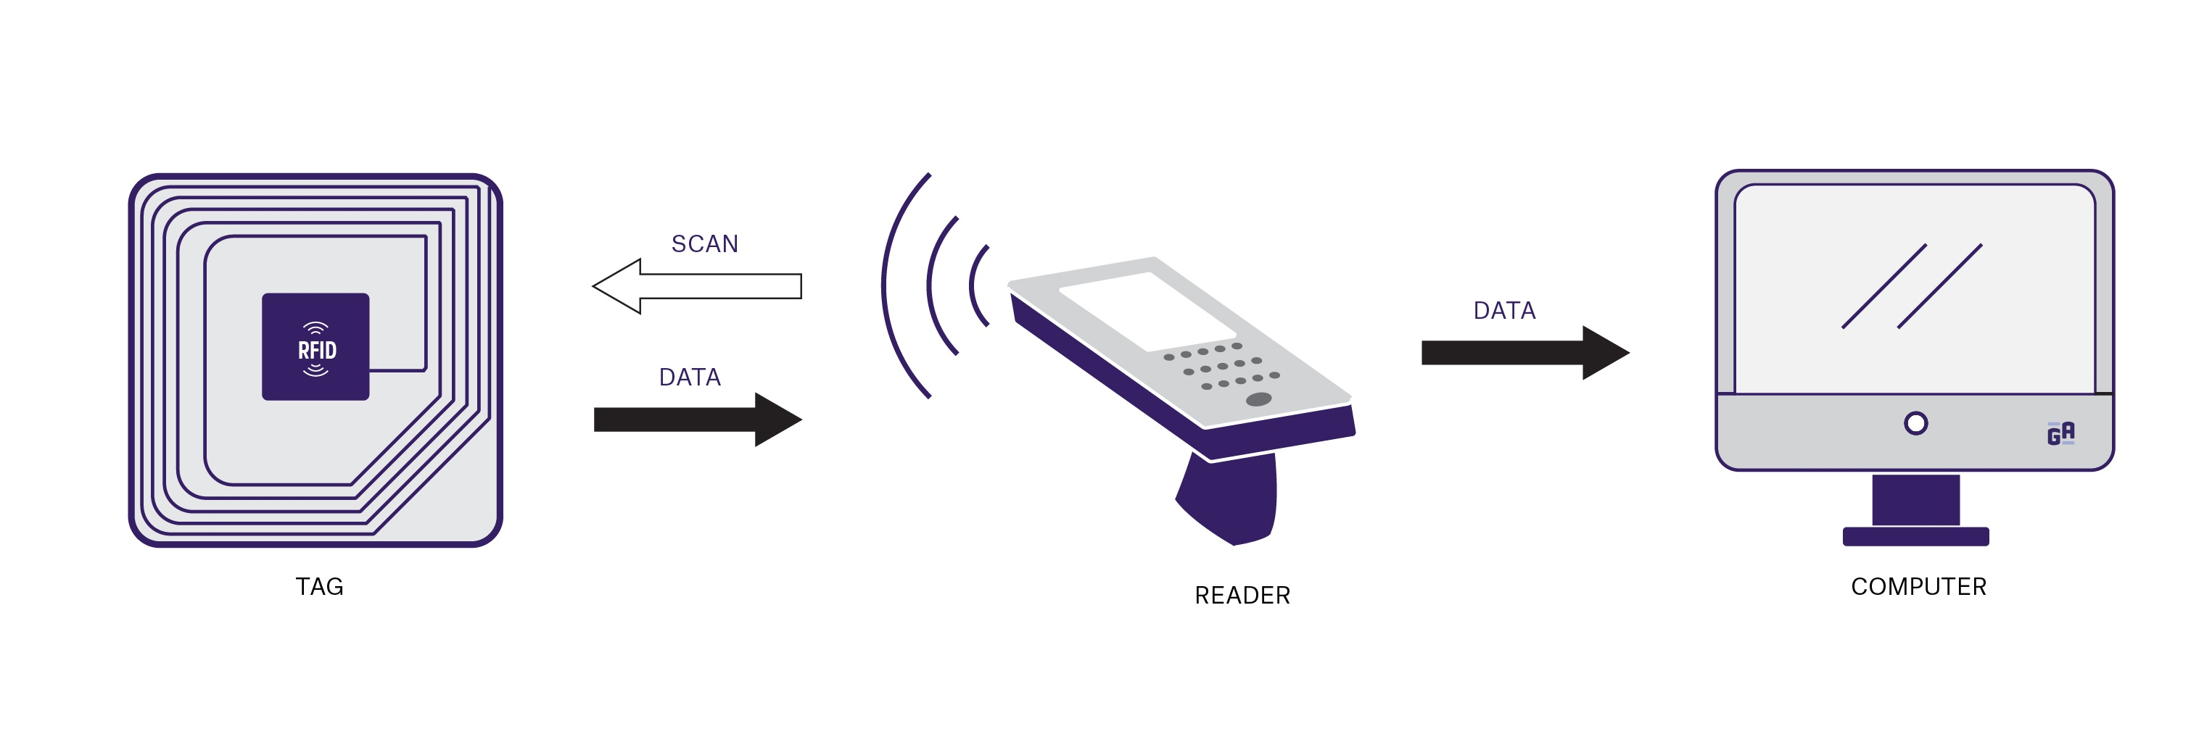
INTRODUCTION
For the most part, in the transportation framework, the procedure of the ticket is taken care by the conductor. He used to gather the sum from the travelling individual and gives the ticket to them. Fundamentally, the entire procedure is finished by paper-based, the printed papers are issued as tickets. introducing days the handholding machines are utilized to print the tickets this framework is having different weaknesses. That traveller needs to convey the printed ticket to the last stop of their destination. That the conductor ought to guarantee that each explorer in the transport is having the ticket are most certainly not. The time taken for the printing of ticket of each individual in the transport is too long. Conductors must be prepared for keeping up the handheld machines. This procedure will take additional time and the abuse of Human Resource and fundamentals as well.
On the other side RFID framework is less time consuming and it follows the cashless India campaign rules. The RFID framework is likewise utilized for tracking also.

Slide 5
LITERATURE REVIEW
SR NO. | DOCUMENT | DATE | DESCRIPTION
1. | Automatic Bus Fare Collection System using RFID March 2017 Authors: Sunitha Nandhini a Sri Krishna College of Technology | March, 2017 | Automatic Fare Collection System implemented by RFID /Smart card . RFID card is given to the passenger and when passenger gets into the bus he has to swipe the card in the RFID reader and he has to a destination point in the device will automatically calculates the fare and deduct the money automatically .
2. | Conductor less Bus Ticketing System Using RFID and Accident Information through GPS and GSM Author: PT.Manikandan, PG. Kalaiyarasi, PK. Priyadharshini, PR.Priyanga | September, 2015 | Count the passenger using IR sensor. GPS & GSM is also used to find the accident location. LED is used as receiver for IR sensor. Here the micro controller used is Atmel 89C52. It is programmable memory.

Slide 6
LITERATURE REVIEW
SR NO. | DOCUMENT | DATE | DESCRIPTION
3. | GPS based Automated Public Transport Fare Collection Systems Based on Distance Travelled by Passenger Using Smart Card Author: Arun Das .S .V, K. Lingeswaran | March, 2014 | The aim of this paper is to provide a comfort tension free and easy way of travelling and also to reduce the man power. This paper involves the combined usage of smart cards and GPS to make travelling smarter. In our paper, Smart card which has become a common thing now, holds the data of the card holders and GPS which is an efficient tool in many fields like surveillance and tracking , which is used in here to find the distance travelled by the user.

Slide 7
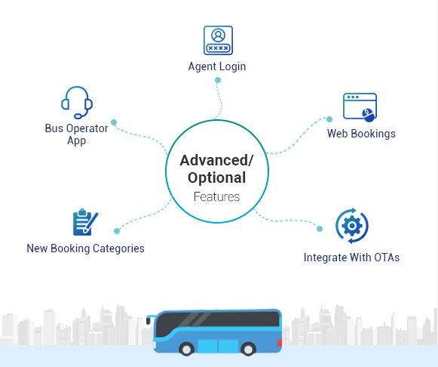
PROBLEM DEFINITION
In recent available systems available across the world and specially in India there are lot of irregularities . In India we have to wait in City bus for a long time to get the ticket and also passenger has to preserve the tickets till destination. Also the ticket is made up of a paper which takes long duration to degrade and it is harmful for environment. In today’s era of globalization the civilians has to waste a long time to search for the city buses and to reach their destination . In India around 60% of the population uses Government transport like , City buses. So to overcome all this problems we have developed the solution with following objectives.

Slide 8
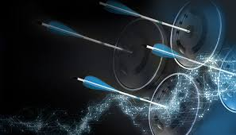
OBJECTIVES
1. Objective is to propose a system which is user friendly.
2. Objective is to use the digital devices to promote paperless, cashless transaction.
3. Objective is to make the faster service of city buses so that Capital generating population can reach in time to their workplace.
4. Objective is to maintain the transparency in Public transport.
5. Objective is to promote the automation in Public transport.

Slide 9
PROPOSED METHODOLOGY
Enter
Scan QR code from Validator
If passenger having mobile go to step 4,If passenger having card go to step 5.
Fill information
• start point (By default it is there)
• No. of passengers
• Age of passenger(By default it is there)
After this go to step 6 and at the time of leaving go to step 7
5) Go to conductor fill information as do in step 4 .
6) Make payment online (Through our account on Website / App).
7) Check payment by conductor.
8) Exit

Slide 10
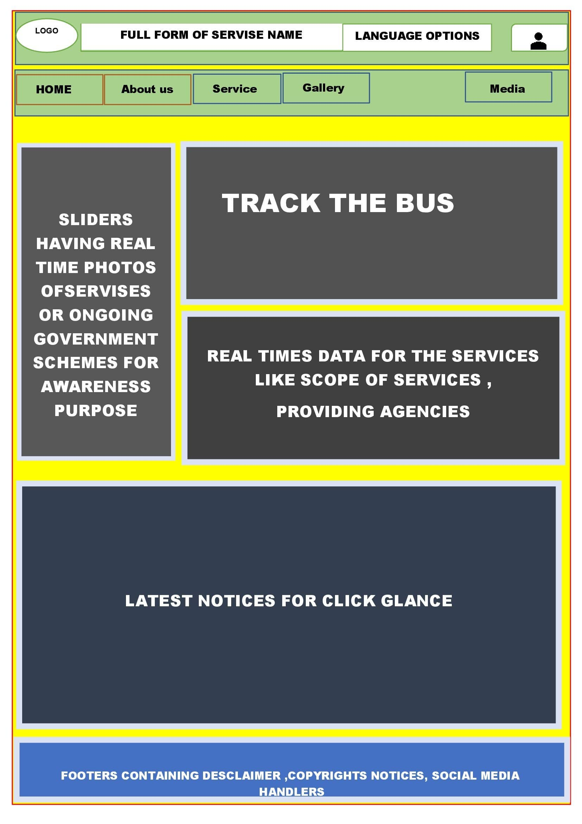
WIREFRAME FOR HOME PAGE

Slide 11
USER AND SYSTEM REQUIREMENTS
Login system: It accepts the username and passwords of the users who are registered on the system.
Authentication: It authenticates the users who are registered already in the system.
Display: This system shows the detailed information or navigation of the whole system. Like link to login, fill details, live location of bus.
Data Filling: An interactive page where we can fill the details of journey. The billing will be generated automatically based on fixed parameters.
Live tracking: The live location of the bus will be shown for the routes.

Slide 12
FUNCTIONAL REQUIREMENTS
1.Live tracking before onboarding
2.Searching Best routes
3.Nearest location for onboarding
4.Easy and lucid signup and login
5.Automatic filling of starting point and manual filling of destination
6.Automatic Ticket amount generation
7.Scanning the correctness of ticket by scanning generated QR code at destination.

Slide 13
NON-FUNCTIONAL REQUIREMENTS
Usability
Security
Reliability
Performance
Availability
Scalability

Slide 14
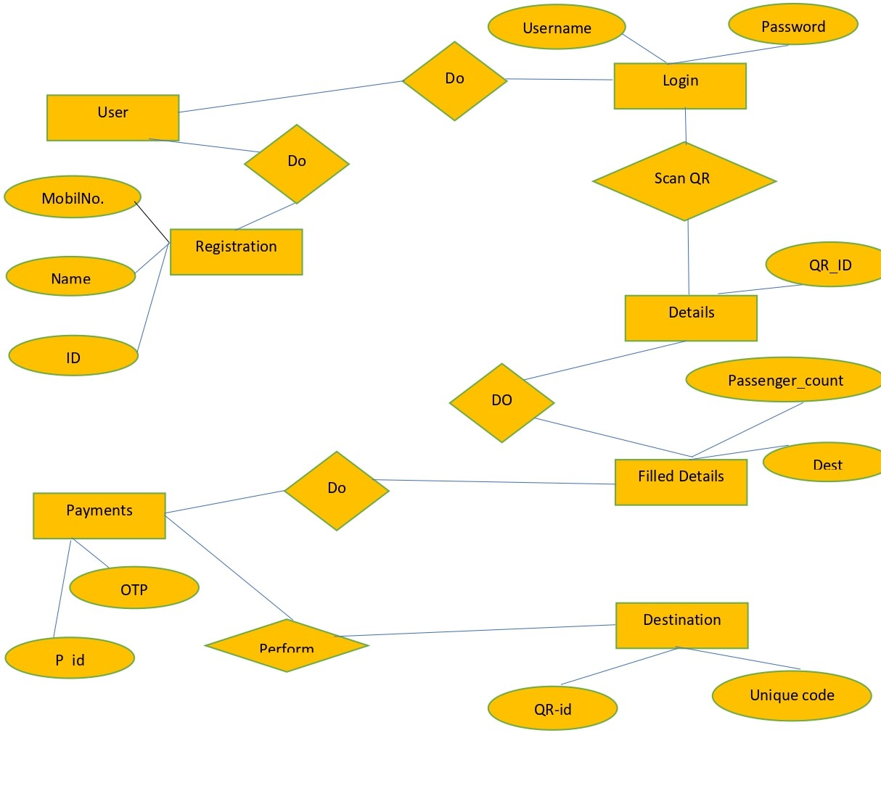
ER- DIAGRAM

Slide 15
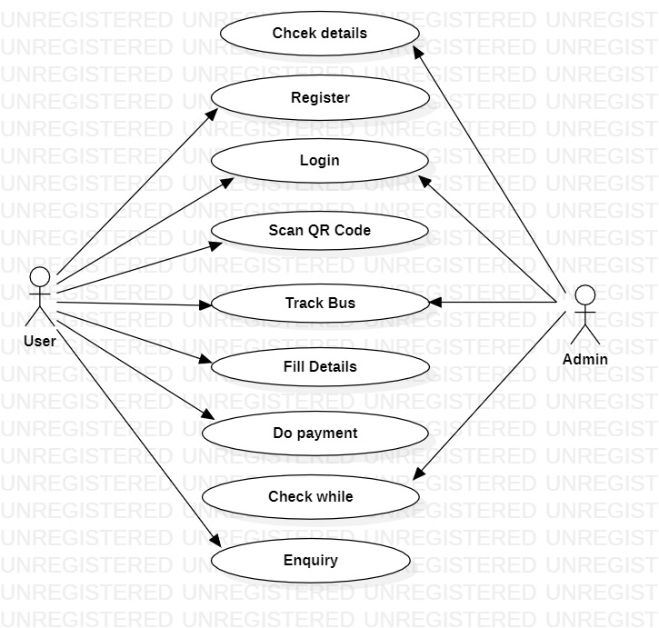
USE CASE DIGRAM

Slide 16
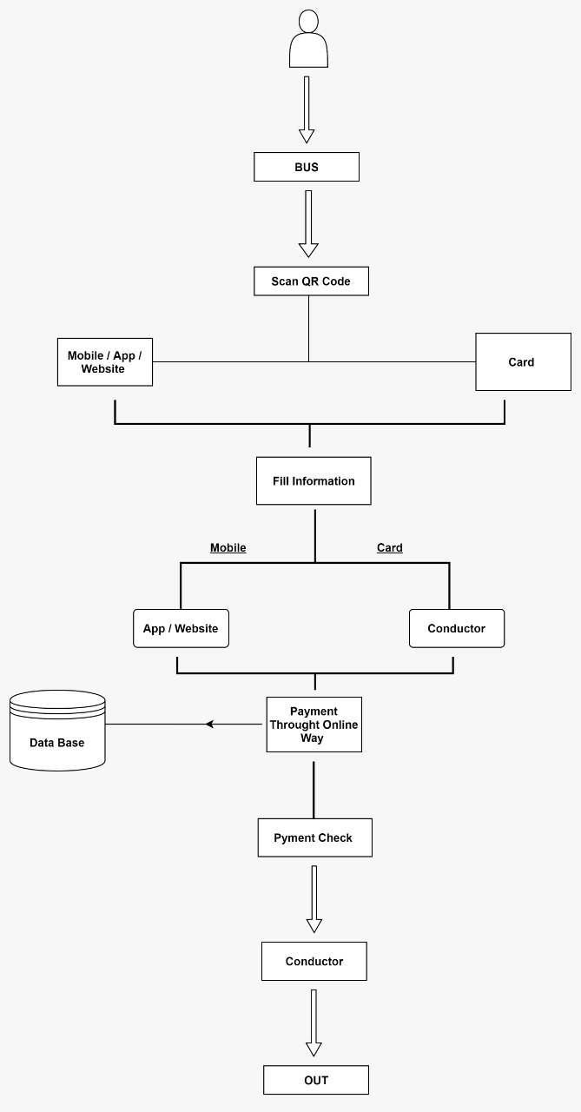
BLOCK DIAGRAM

Slide 17
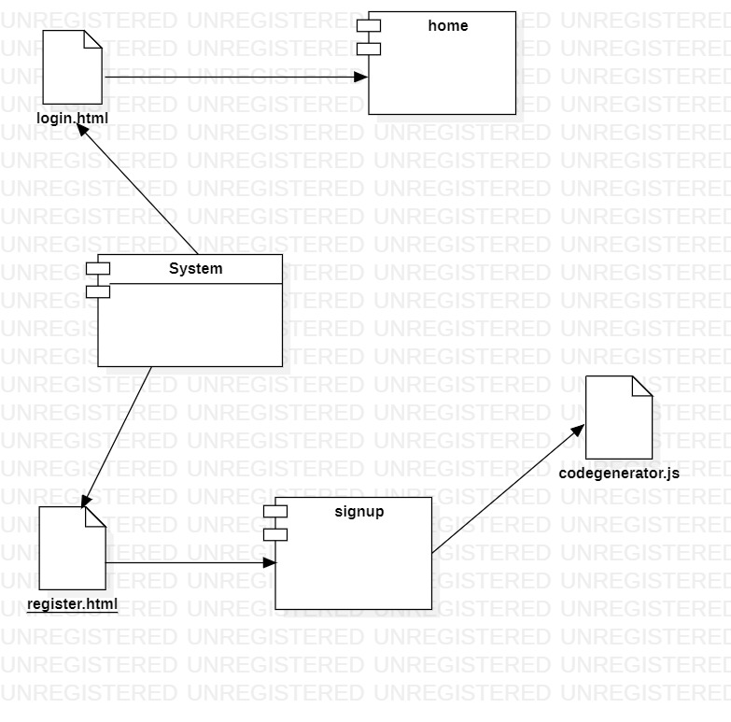
Component Diagram

Slide 18
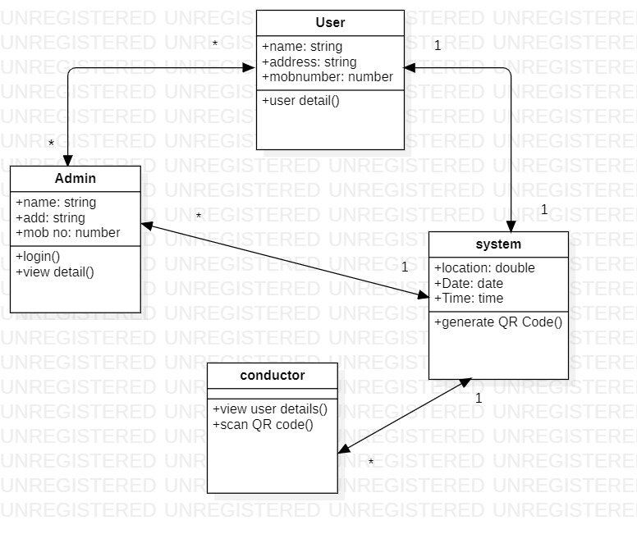
Class DIAGRAM

Slide 19
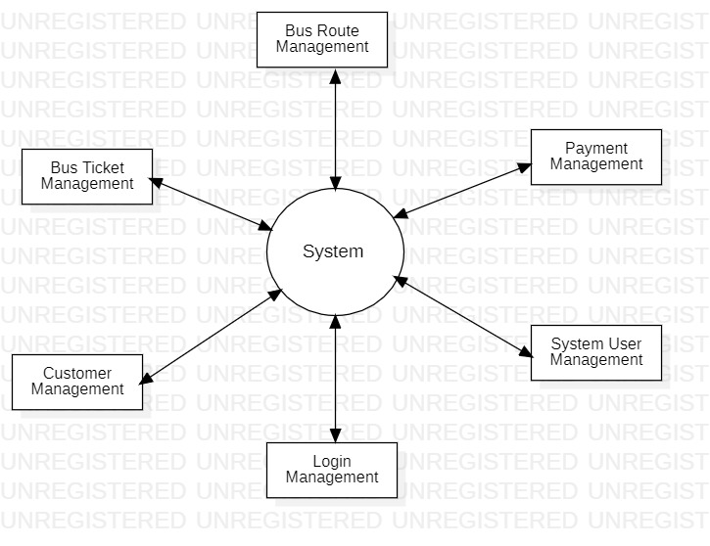
DFD LEVEL 0 DIAGRAM

Slide 20
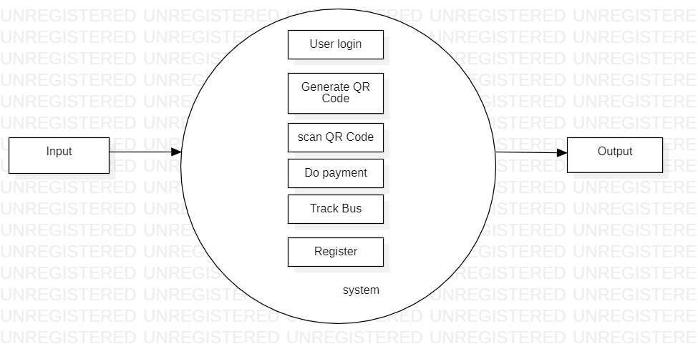
DFD LEVEL 1 DIagram

Slide 21
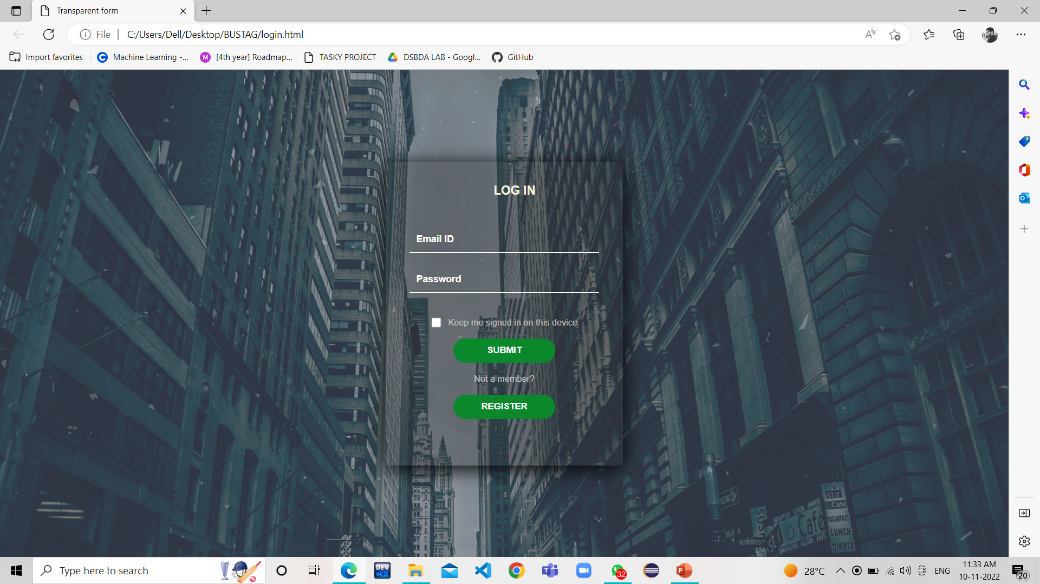
LOGIN PAGE

Slide 22
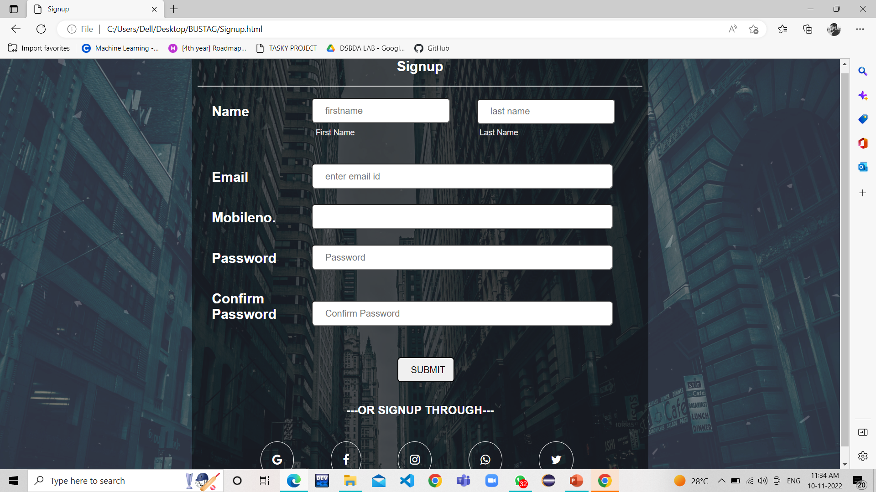
SIGN UP PAGE

Slide 23
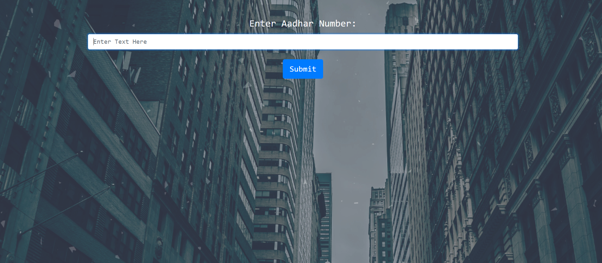
QR PAGE

Slide 24
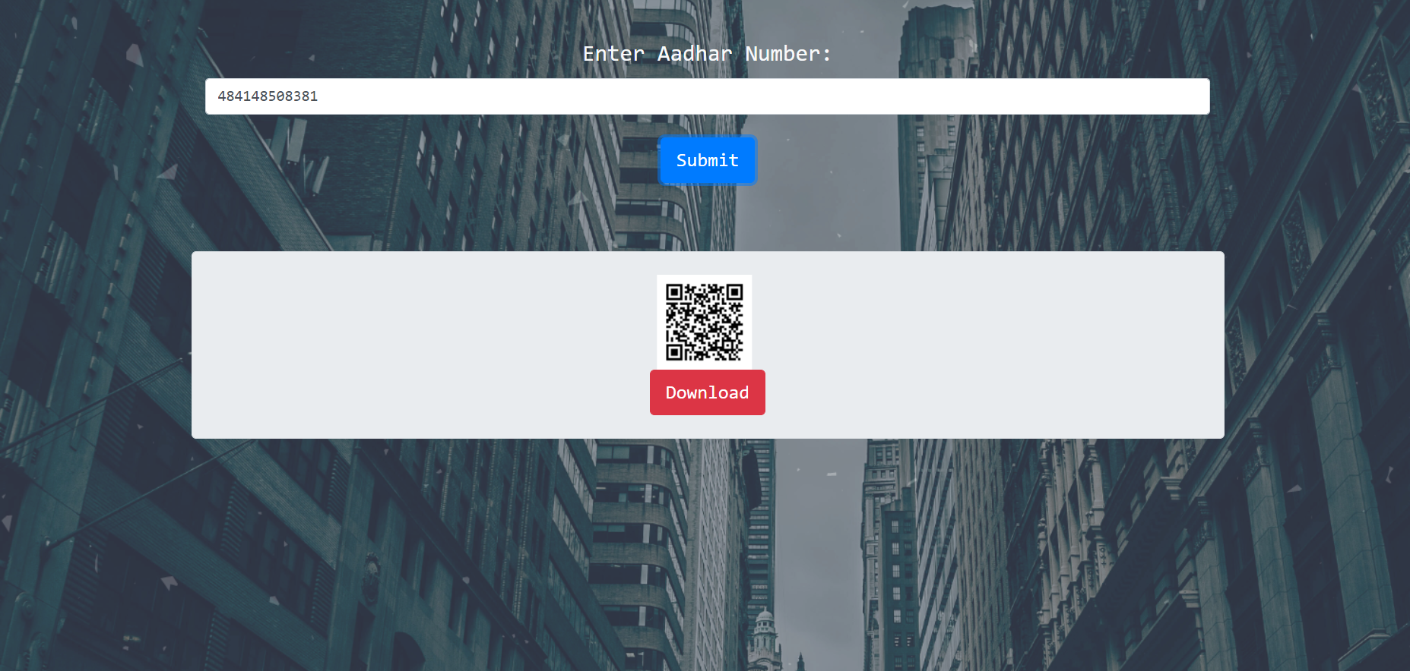

Slide 25
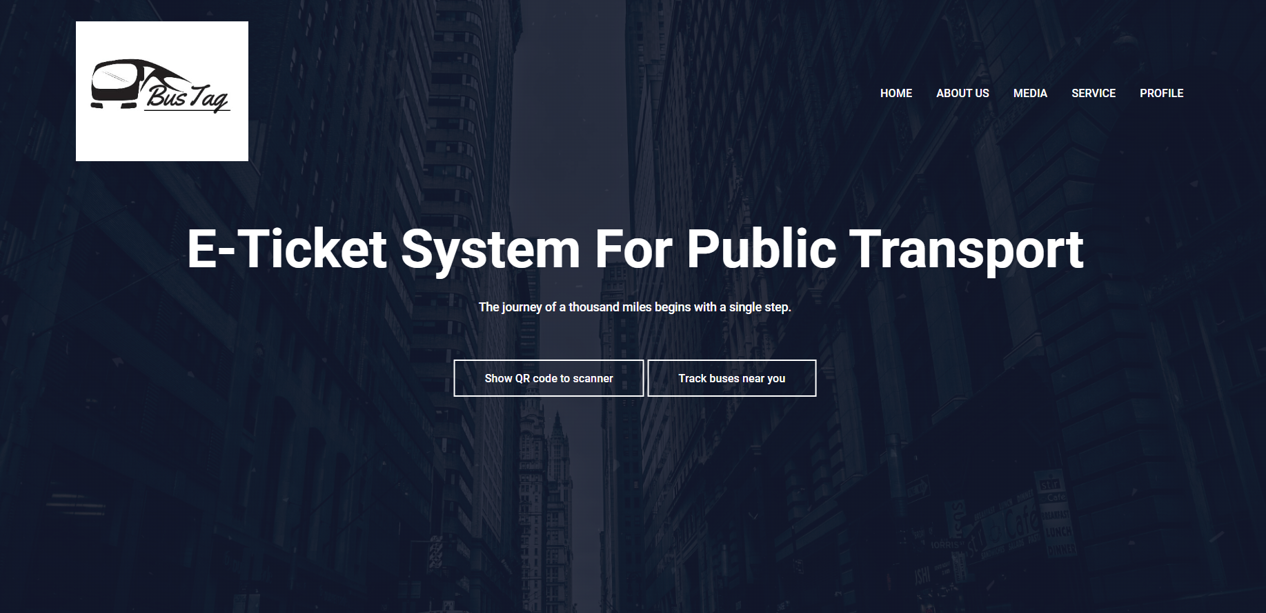
HOME PAGE

Slide 26
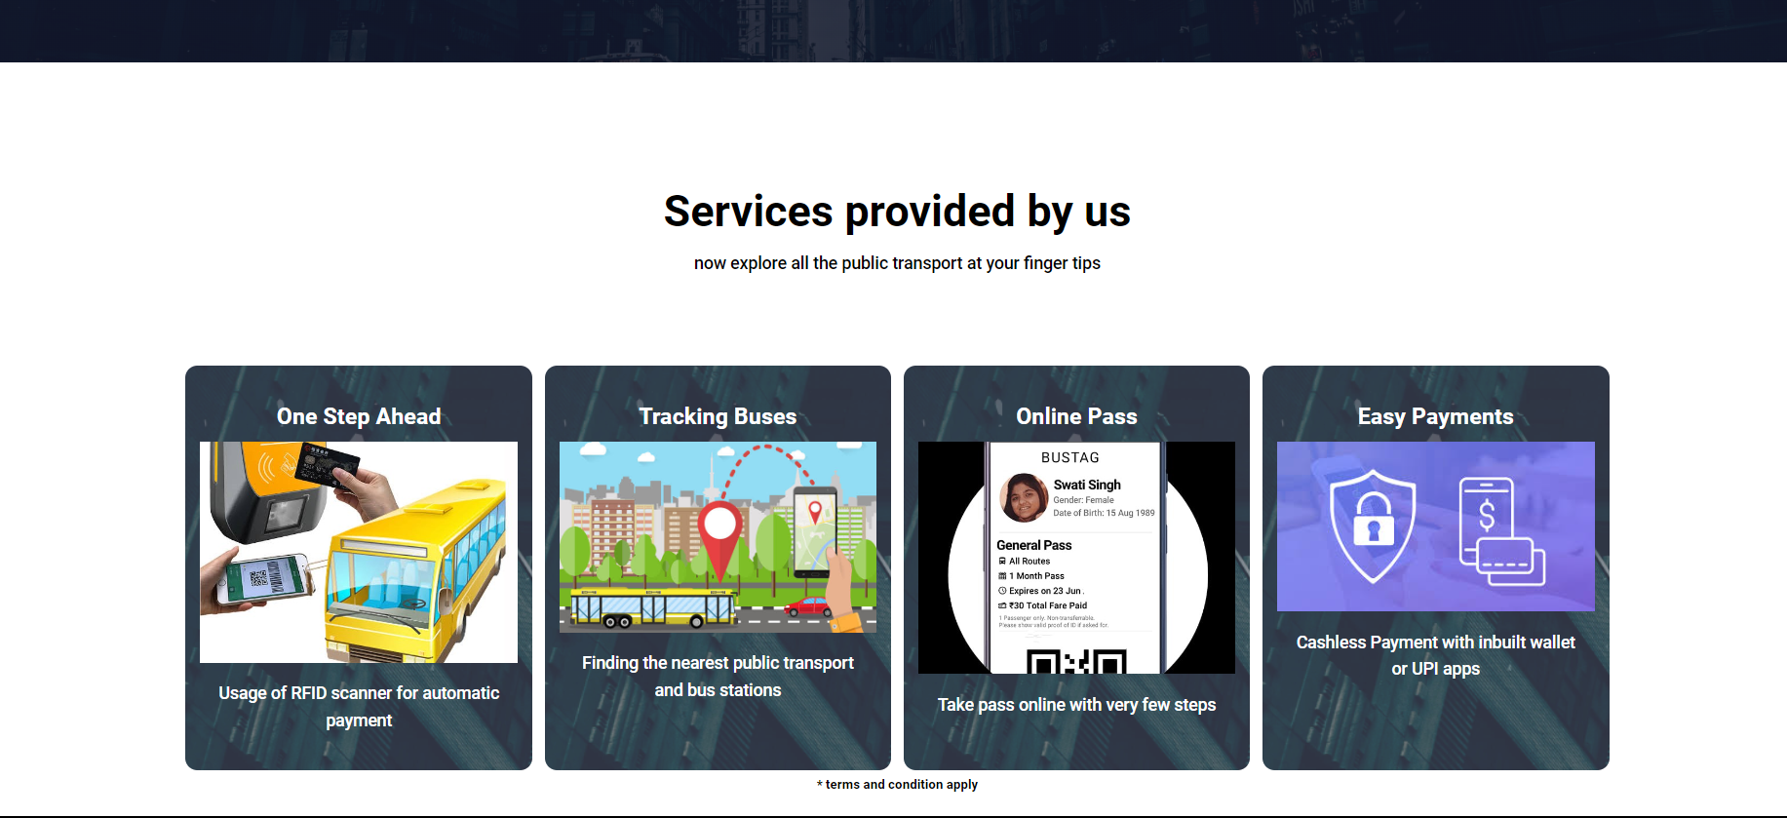

Slide 27
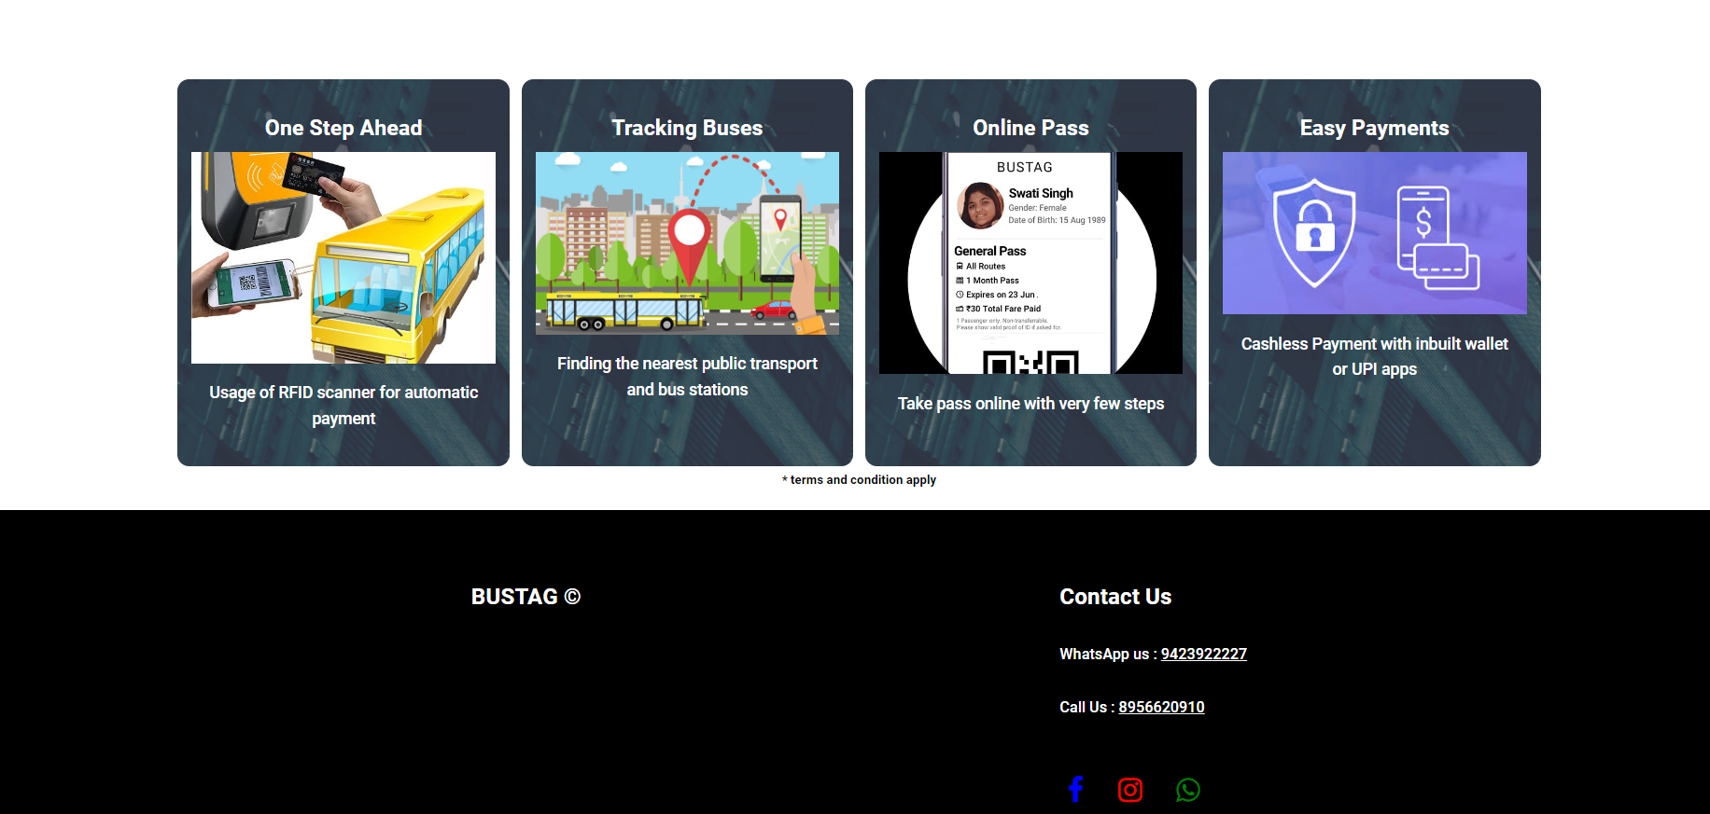

Slide 28
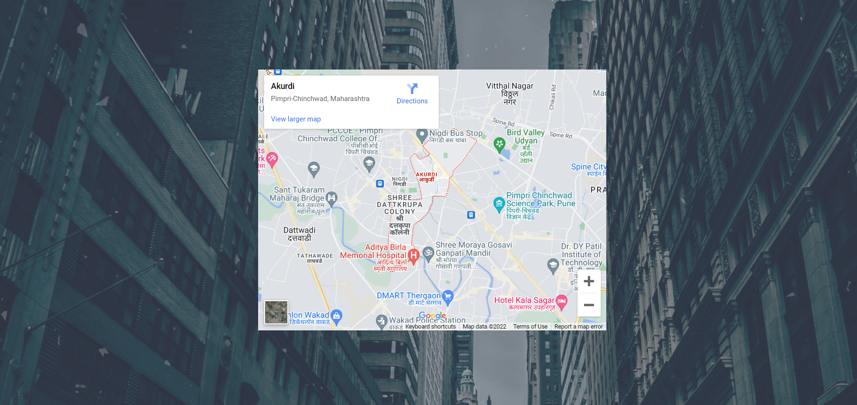
MAP PAGE

Slide 29
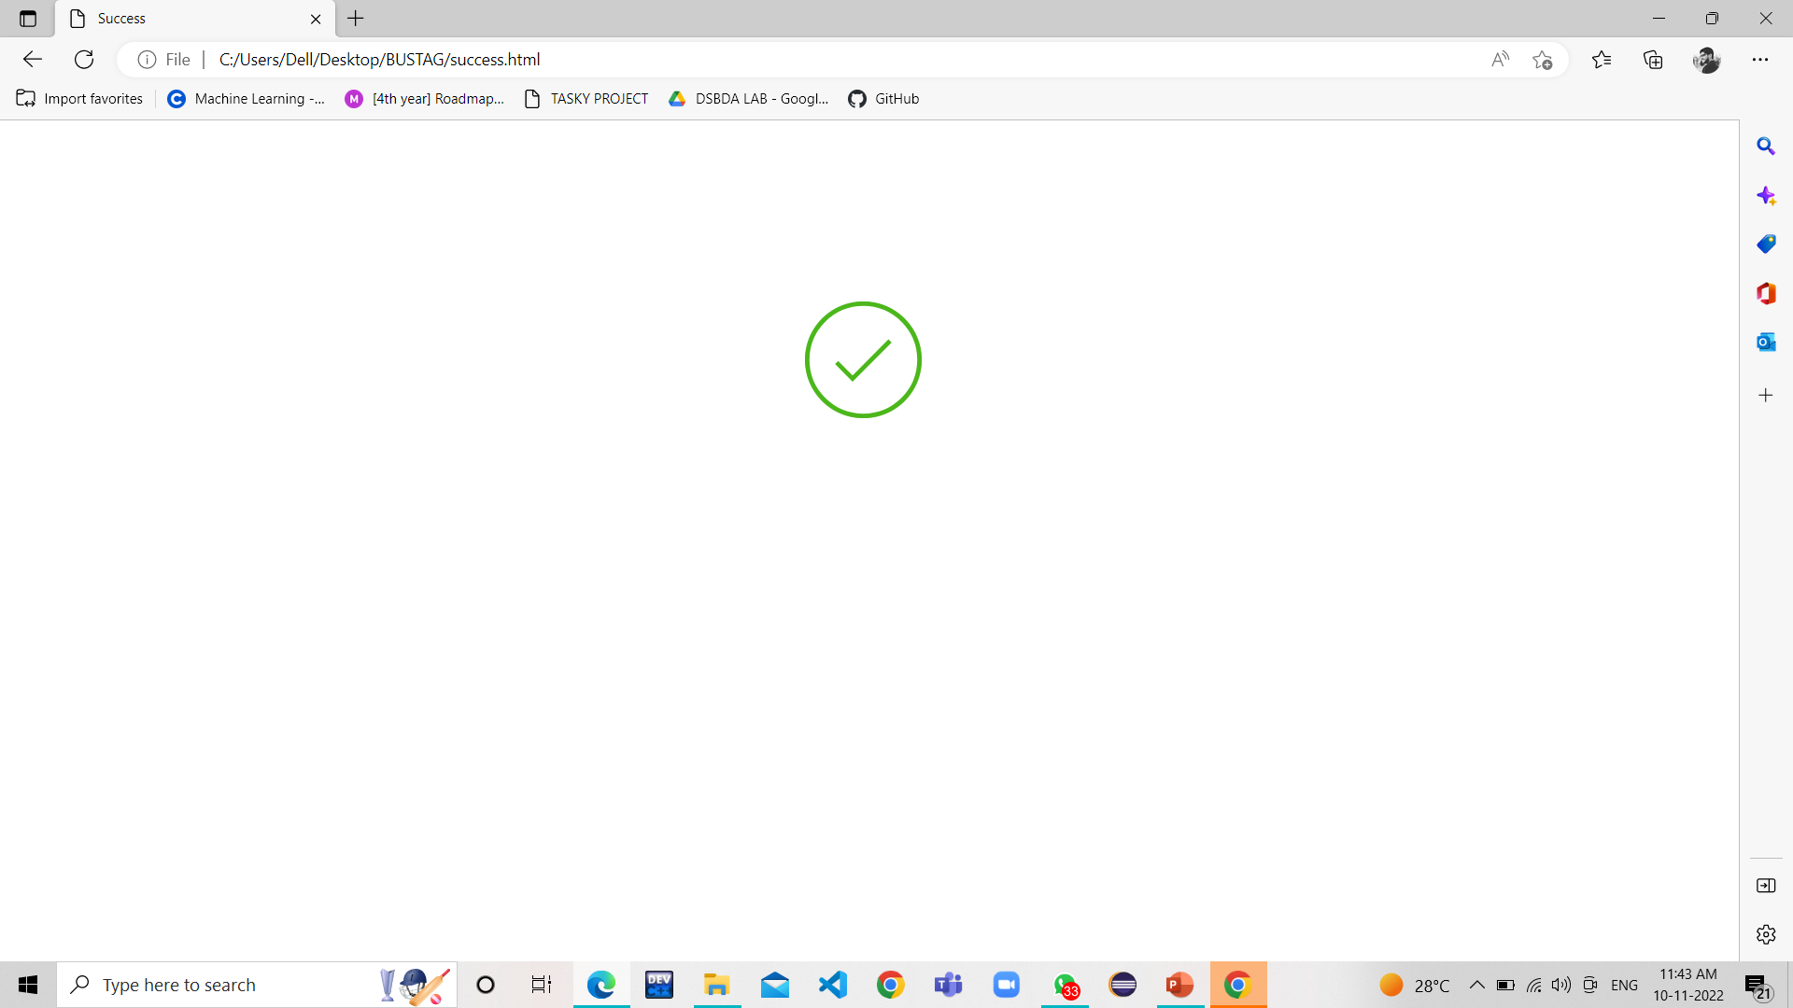
PAYMENT PAGE

Slide 30
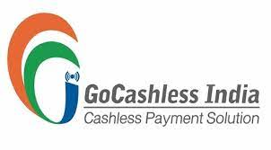
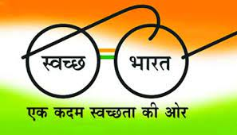

CONCLUSION
Our project is an clean and clear advancement of research paper of “UTTP advancing public transport”. The project will be supplementing the government schemes like, “Digital India Campaign", "Swachh Bharat Mission”. For the people who are working in backend technology and the system upgradation , the system is so friendly to implement.
The proposed system will bring a change as per the requirement of people so that they can rapidly buy the ticket and work accordingly.

Slide 31
REFERENCES
[1] Automated Bus Ticketing System Using RFID, 2019 2nd International Conference on Intelligent Computing, Instrumentation and Control Technologies (ICICICT), Date of Conference: 5-6 July 2019
[2] Bus Ticket System for Public Transport Using QR Code
C. Upendra Reddy¹, D.L.S. Vara Prasad Reddy¹, N. Srinivasan² and J Albert Mayan³
Published under licence by IOP Publishing Ltd - IOP Conference Series: Materials Science and Engineering, Volume 590, International Conference on Frontiers in Materials and Smart System Technologies 10 April 2019.
[3] An introduction to FASTAG : A Game Changer In Automatic Toll Collection System In India. 1S.Amrin1Assistant Professor1Computer Science, 1Indian Academy Group of Institutions, Bangalore, India , June 2019.
[4] Smart E-Ticketing System for Public Transport Bus
Author: Sanam Kazi; Murtuza Bagasrawala; Farheen Shaikh; Anamta Sayyed

